Slide 1
NLP 2
Embeddings, RNN, LSTM

Slide 2
Sentiment Analysis
WHAT IT IS: Automatically identifying the emotional tone behind a body of text. Is it positive, negative, or neutral?
EXAMPLE:
Input Text: "The battery life on this new phone is incredible, but the camera quality is a bit disappointing."
Model Output:
Battery Life: Positive
Camera Quality: Negative
WHY IT'S USEFUL: Instantly gauge customer feedback from thousands of reviews, monitor social media brand perception, and prioritize customer support tickets.

Slide 3
Named Entity Recognition (NER)
WHAT IT IS: Locating and classifying named entities in text into pre-defined categories such as person names, organizations, locations, medical codes, time expressions, etc.
EXAMPLE:
Input Text: "On Tuesday, Apple Inc. announced that Tim Cook would be presenting the keynote from their headquarters in Cupertino."
Model Output:
Apple Inc.: [ORGANIZATION]
Tim Cook: [PERSON]
Cupertino: [LOCATION]
On Tuesday: [DATE]
WHY IT'S USEFUL: Structuring information, improving search engine algorithms, and automatically summarizing key information from documents.

Slide 4
Machine Translation
WHAT IT IS: Automatically translating text from one language to another.
EXAMPLE:
Input Text (Spanish): "La inteligencia artificial está transformando nuestro mundo."
Model Output (English): "Artificial intelligence is transforming our world."
WHY IT'S USEFUL: Breaking down communication barriers globally, from real-time conversation apps to localizing websites and software. This is far more complex than a simple word-for-word dictionary lookup.

Slide 5
Text Summarization & Question Answering
WHAT THEY ARE:
Summarization: Creating a short, accurate, and fluent summary of a longer text document.
Question Answering (QA): Providing a specific answer to a user's question based on a given context document.
EXAMPLE (QA):
Context: "The Eiffel Tower was constructed from 1887 to 1889 as the centerpiece of the 1889 World's Fair. It was designed by the engineering firm of Gustave Eiffel."
Question: "Who designed the Eiffel Tower?"
Model Output: "the engineering firm of Gustave Eiffel"
WHY THEY'RE USEFUL: Quickly digesting long reports, research papers, or news articles. Powering virtual assistants and search engines.

Slide 6
Bag-of-words
The idea is simple: represent a document by the counts of its words, ignoring grammar and word order.
EXAMPLE:
Sentence 1: "The cat sat on the mat"
Sentence 2: "The mat sat on the cat"
BoW Representation (for both):
{"the": 2, "cat": 1, "sat": 1, "on": 1, "mat": 1}
LIMITATIONS:
No Order: The model sees Sentence 1 and Sentence 2 as identical. The sequential information, which is vital for meaning, is completely lost.
No Meaning: The model has no idea that "cat" and "kitten" are related. Or that "happy" and "joyful" are similar. To the model, they are just as different as "cat" and "rocket".

Slide 7
Bow: Step 1: Tokenize and Build a Vocabulary
First, you collect every unique word from your entire set of documents (the corpus) to create a master list, or vocabulary.
Corpus:
Sentence 1: "The cat sat on the mat.“
Sentence 2: "The dog ate the homework.“
Vocabulary (unique, lowercase words):
['the', 'cat', 'sat', 'on', 'mat', 'dog', 'ate', 'homework']

Slide 8
Bow: Step 2: Create a Zero Vector for Each Document
Each document is represented by a vector that is the same size as the vocabulary, initially filled with zeros.
Vector for Sentence 1: [0, 0, 0, 0, 0, 0, 0, 0]
Vector for Sentence 2: [0, 0, 0, 0, 0, 0, 0, 0]
Step 3: Fill in the Word Counts
Go through each document and count the occurrences of each vocabulary word.
Sentence 1 Vector: [2, 1, 1, 1, 1, 0, 0, 0]
(Corresponds to counts for ['the', 'cat', 'sat', 'on', 'mat', 'dog', 'ate', 'homework'])
Sentence 2 Vector: [2, 0, 0, 0, 0, 1, 1, 1]

Slide 9
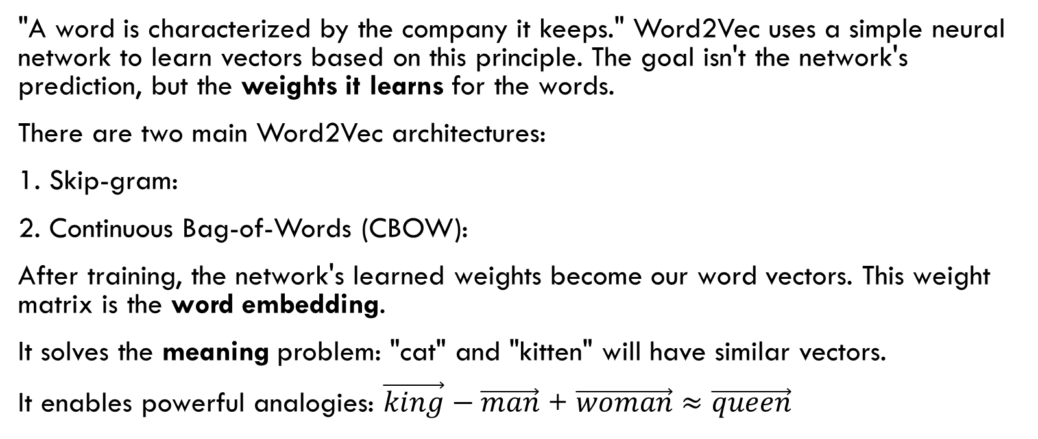
Word Embeddings
"A word is characterized by the company it keeps." Word2Vec uses a simple neural network to learn vectors based on this principle. The goal isn't the network's prediction, but the weights it learns for the words.
There are two main Word2Vec architectures:
1. Skip-gram:
2. Continuous Bag-of-Words (CBOW):
After training, the network's learned weights become our word vectors. This weight matrix is the word embedding.
It solves the meaning problem: "cat" and "kitten" will have similar vectors.
It enables powerful analogies: $\vec{king}−\vec{man}$ + $\vec{woman}$ $≈$ $\vec{queen}$

Slide 10
Skip-gram
Task: Predict context words given a single target word.
Example: Consider the sentence "...the quick brown fox jumps..." and a window size of 2.
If the target word is "brown", the context words are the, quick, fox, jumps.
The model creates training pairs: (brown, quick), (brown, fox), etc.
How it Works: The model takes the vector for "brown" and tries to predict "quick". The error between its prediction and the actual word "quick" is used to adjust the vectors for both "brown" and "quick" so they become slightly better predictors for each other. This is repeated for millions of pairs.

Slide 11
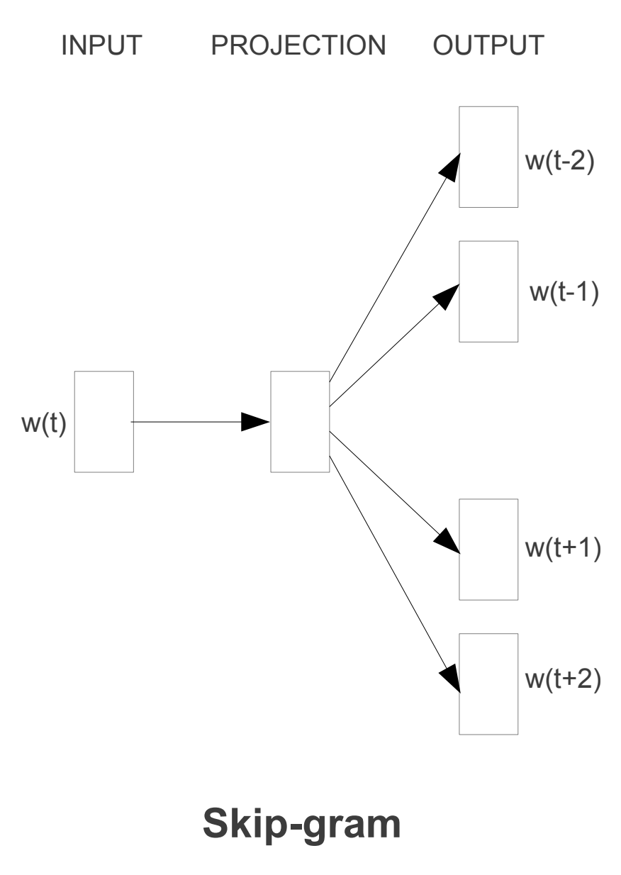
Skip-gram
The Neural Network Structure
Input Layer: Represents the input word(s).
Hidden Layer (also called the Projection Layer): The size of this layer determines embedding dimension (e.g., 300). There is no activation function (like Sigmoid or ReLU) on this layer; it's a direct, linear projection.
Output Layer: A standard softmax layer that produces a probability distribution over entire vocabulary.
Input: A single word (e.g., "brown"), represented as a one-hot vector (a vector of all zeros except for a 1 at the index for "brown").

Slide 12
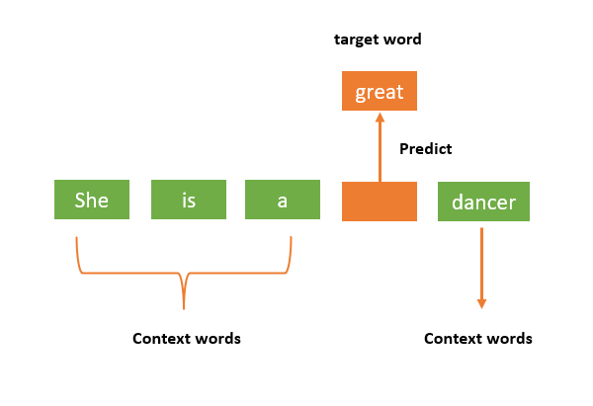
Continuous Bag-of-Words (CBOW):
Task: Predict a target word from its surrounding context words.
Example: Using the same sentence "...the quick brown fox jumps..." and a window size of 2.
The context words are [the, quick, fox, jumps].
The target word to predict is "brown".
How it Works: The model takes the vectors for all the context words, typically averages them to get a single context vector, and then uses that vector to predict the middle word, "brown". The error is then used to adjust the vectors of all the context words.

Slide 13
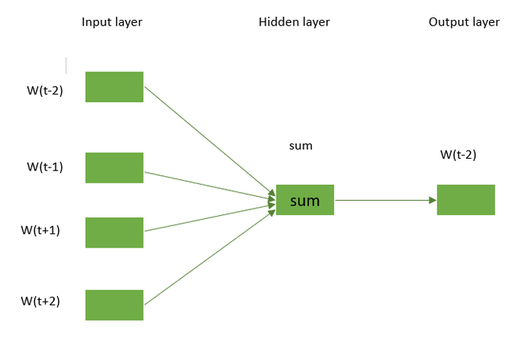
Continuous Bag-of-Words (CBOW):
Input: The surrounding context words (e.g., ["the", "quick", "fox", "jumps"]). The vectors for these words are retrieved from the hidden layer and averaged to create a single input vector.

Slide 14
RNN
An RNN is designed to work with sequences. It processes one element at a time (e.g., one word) while maintaining a "hidden state" — a memory of what it has seen so far.
An RNN cell takes two inputs at each step t:
The input at that step (e.g., the word embedding for x_t).
The hidden state from the previous step (h_{t-1}).
It then produces two outputs:
A prediction for the current step (output_t).
The new hidden state to be passed to the next step (h_t).

Slide 15
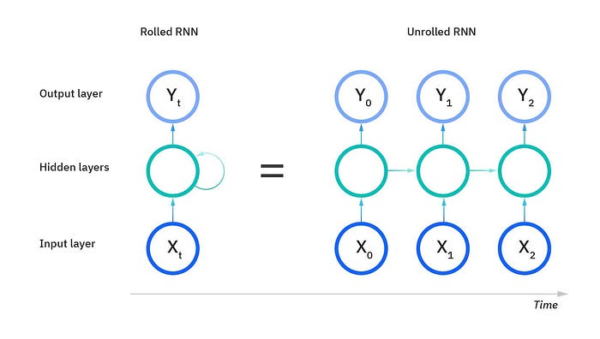
RNN
The “rolled” visual of the RNN represents the whole neural network, or rather the entire predicted phrase. The “unrolled” visual represents the individual layers, or time steps, of the neural network. Each layer maps to a single word in a phrase. Prior inputs, would be represented as a hidden state in the third timestep to predict the output in the sequence.

Slide 16
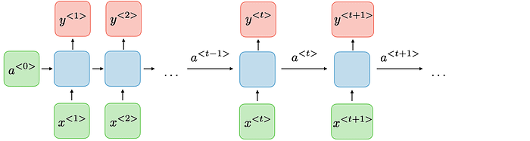
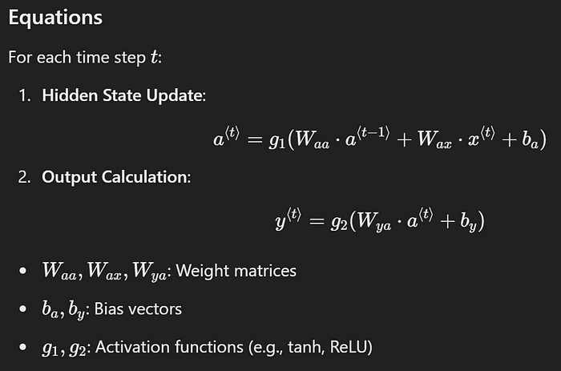
RNN

Slide 17
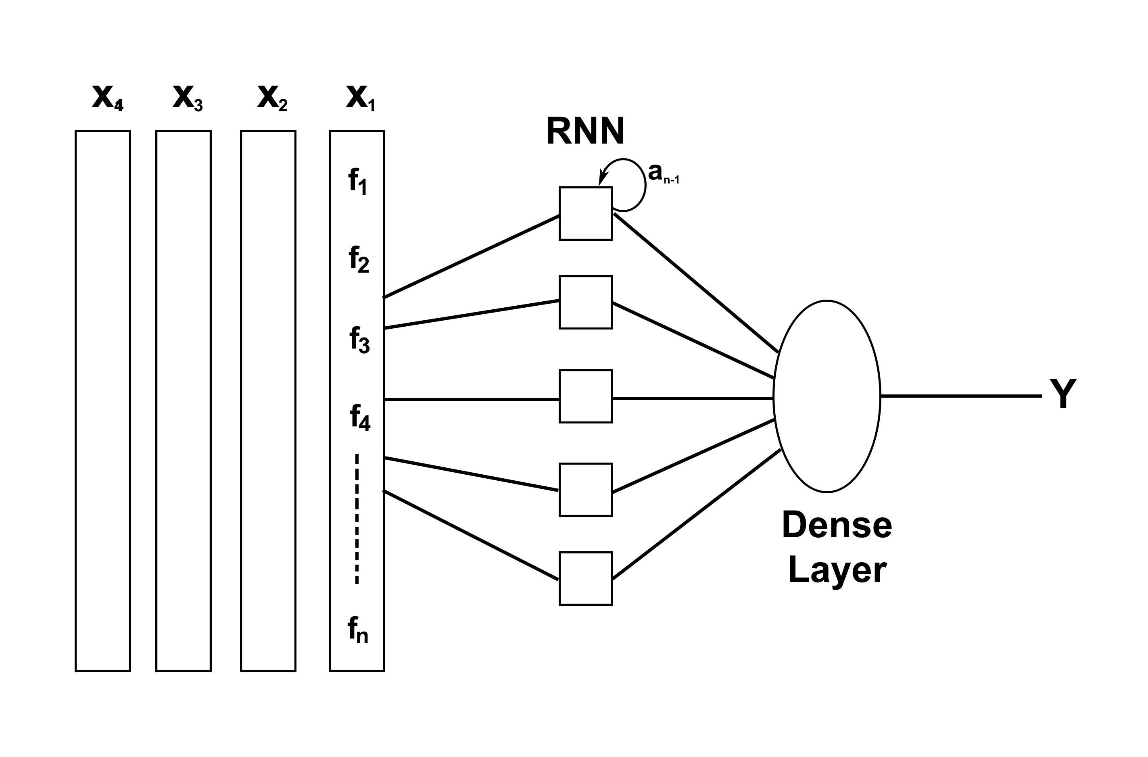
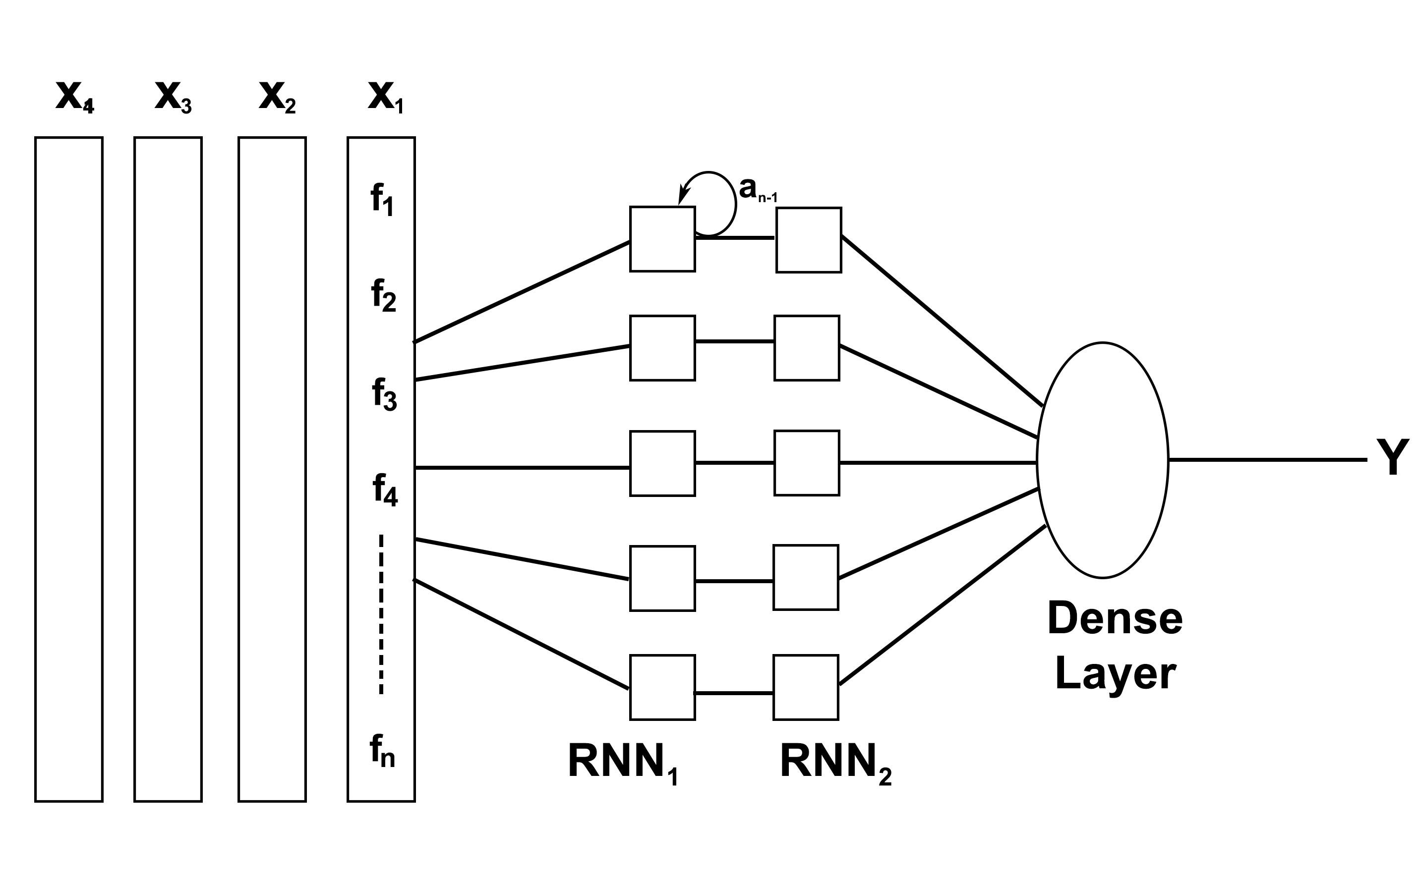
RNN Architectures
RNNs can be structured in various ways to suit different tasks:
One-to-One: Standard neural network (e.g., image classification).
One-to-Many: Single input, sequence output (e.g., image captioning).
Many-to-One: Sequence input, single output (e.g., sentiment analysis).
Many-to-Many (Same Length): Sequence input and output of the same length (e.g., named entity recognition).
Many-to-Many (Different Length): Sequence input and output of different lengths (e.g., machine translation).

Slide 18
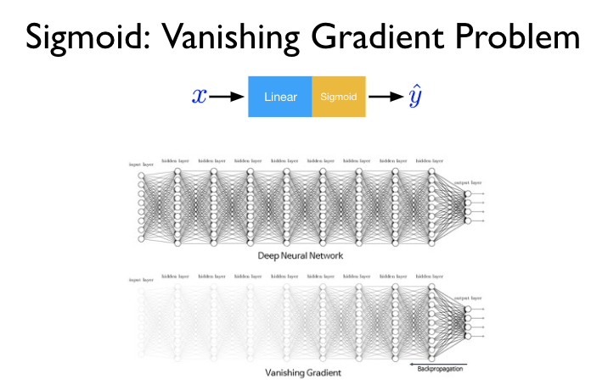
Vanishing gradient
What are Gradients? Think of the gradient as the "error signal" that tells each weight in the network how to update itself to improve the model's overall performance. This signal is passed backward through the network during training in a process called backpropagation.
Vanishing Gradients: In a deep network or a long sequence, as the gradient is backpropagated from the end to the beginning, it's repeatedly multiplied by small numbers. This can cause the signal to shrink exponentially until it becomes practically zero.
Impact on RNNs: The error signal from the end of a long sentence fades away before it can reach the beginning. This means the network can't learn dependencies between words that are far apart. The model effectively has short-term memory—it forgets what it saw at the start of the sequence.

Slide 19
LSTM
LSTMs are a special kind of RNN, explicitly designed to combat the vanishing gradient problem. Their default behavior is to remember things for long periods.
An LSTM cell is more complex than a standard RNN cell. It contains a cell state (like a memory conveyor belt) and three "gates" that act as controllers.
Forget Gate: Looks at the previous hidden state and the current input and decides what information to throw away from the cell state.
Input Gate: Decides what new information from the current input is important and should be stored in the cell state.
Output Gate: Decides what part of the cell state should be used to make the output prediction for the current time step.
THE RESULT: By learning what to remember, what to forget, and what to output, LSTMs can successfully capture dependencies and relationships over very long sequences, making them incredibly powerful for most modern NLP tasks.

Slide 20
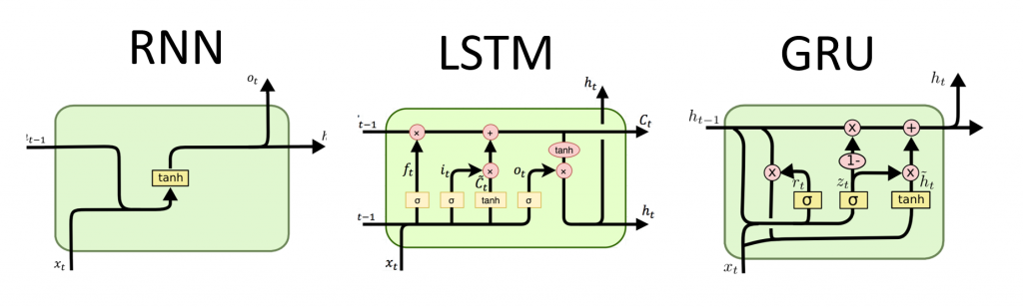
LSTM

Slide 21
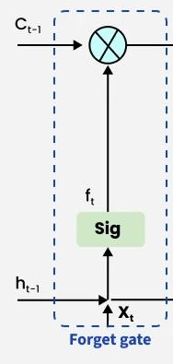


LSTM: Forget gate
The information that is no longer useful in the cell state is removed with the forget gate. Two inputs xt​ (input at the particular time) and ht−1 (previous cell output) are fed to the gate and multiplied with weight matrices followed by the addition of bias. The resultant is passed through an activation function which gives a binary output. If for a particular cell state the output is 0, the piece of information is forgotten and for output 1, the information is retained for future use.
The equation for the forget gate is:
Where:
Wf represents the weight matrix associated with the forget gate.
- denotes the concatenation of the current input and the previous hidden state.
bf is the bias with the forget gate.
σ is the sigmoid activation function.

Slide 22
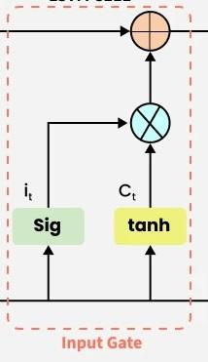


LSTM: Input Gate
The addition of useful information to the cell state is done by the input gate. First the information is regulated using the sigmoid function and filter the values to be remembered similar to the forget gate using inputs ht−1​and xt​. Then, a vector is created using tanh function that gives an output from -1 to +1 which contains all the possible values from ht−1​ and xt​. At last the values of the vector and the regulated values are multiplied to obtain the useful information. The equation for the input gate is:
We multiply the previous state by ft effectively filtering out the information we had decided to ignore earlier. Then we add it⊙Ct​ which represents the new candidate values scaled by how much we decided to update each state value.
where
⊙ denotes element-wise multiplication
tanh is activation function

Slide 23
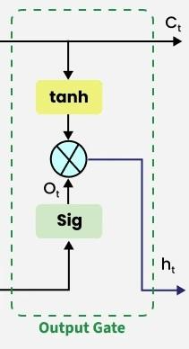

LSTM: Output gate
The task of extracting useful information from the current cell state to be presented as output is done by the output gate. First, a vector is generated by applying tanh function on the cell. Then, the information is regulated using the sigmoid function and filter by the values to be remembered using inputs ht−1​and xt. At last the values of the vector and the regulated values are multiplied to be sent as an output and input to the next cell. The equation for the output gate is:

Slide 24
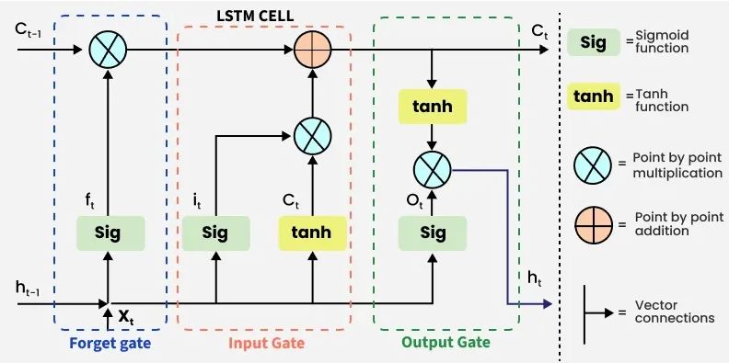
lstm

Slide 25
What’s next
Attention
Transformers

